Slide 1
Content
Introduction: Juvenile Drugs Use
Reasons for Drugs Use
Parties affected by Drugs Use
Dangers associated with Drugs
Possible solutions
Conclusion
References

Slide 2
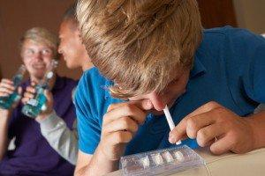
Introduction: Juvenile Drugs Use
Topic
Attention Getter.
Credibility – Audience Relevance.
Goal as proposition.
Preview of points.
Notes:
Did you know that, according to the United Nations Office on Drugs and Crime 2018, 13.8 million young people who are mostly students aged between 15 to 16 years used cannabis at least once in 2016? Today I will be talking to you about this subject because you might know someone who is affected by these drugs or even someone here today among yourselves. First, I will talk about the reasons why juveniles are storming into the use of drugs. Then secondly, we will explore the main dangers of early usage of drugs focusing on both risks with the Law and Healthwise. Thirdly, I will show you the reasons why we need to shun away from drugs as students and youths. Lastly, we will look at the possible solutions to deal with the situation and reduce the impact it has on our society.

Slide 3

Parties Affected by Drug Use
Individual families
Community
The government
The economy
Individual users.
Notes:
Individual users of the drugs are the main subjects and the prime victims of drugs use. It is there mental and physical conditions that are at risk and there lives are at stake too. The community and families of the affected juvenile is also at stake with the feeling of loneliness and sense of losing someone all around their minds. They can lose their loved ones forever through death or imprisonment. The economy of the country also feels the burden as a significant amount of funds is used to implement strategies to save these juveniles on drugs as well as improving health facilities to carter for their treatment.

Slide 4
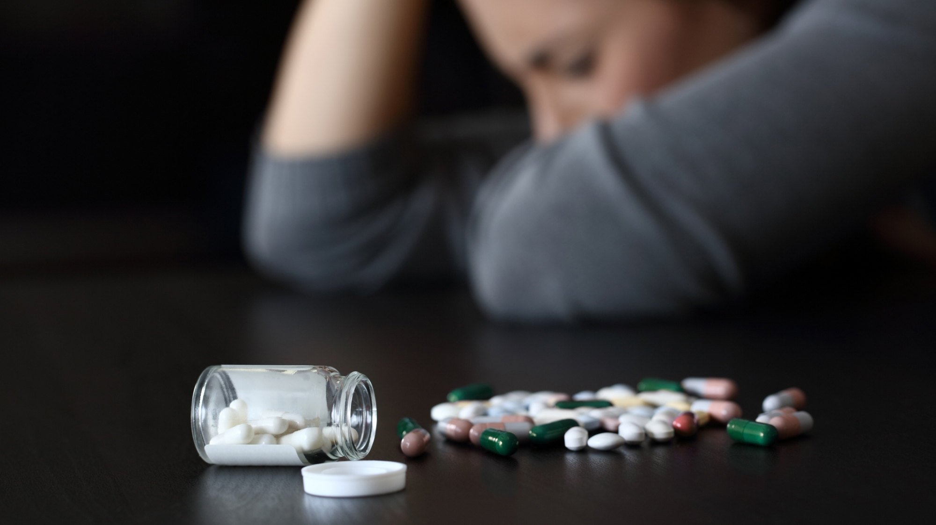
Reasons for Drugs Use
Depression
Peer pressure
Misinformation
Experimentation
Environmental factors
Notes:
First, I will begin by highlighting the reasons why individuals as young as below 18 years of age might find himself/herself drowned into drugs. The first notable reason is peer pressure from the others around them. This is the pressure from friends and people around them who are already using the drugs. Early exposure to drug substance use or abusive behaviors acts as an important mechanism to facilitate juveniles to try them out. The socio-economic status of the parents can result in a great depression, which might force children to venture into drugs to cope up with the pressure and stress. The curiosity of young people is always high, and some start drugs just for experimentation to get the answer on how pills taste or feel.

Slide 5
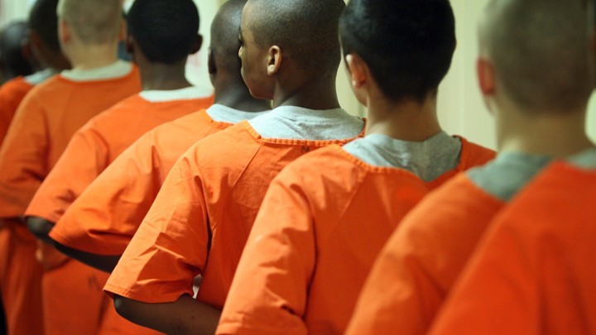
Dangers associated with Drugs
Brain damage
Depression
Death
Drop out of school
Prison sentence or jail terms
Chest pain and breathing difficulties
Increases criminal activities
Notes:
The dangers of drugs can be felt by families, communities, the state, and individual users. To the victims using the drugs, it can cause a permanent mental impairment, which might result in memory loss. Drug use among juveniles increases the levels of criminal activities in the community. Since the subjects are not financially stable or self-supported, the users turn to criminal activities to raise funds to and purchase drugs and settle their addiction. Drugs like Marijuana, are mutagenic and can impair the breathing system of the user and chest pains. In the majority of countries, possession and buying of drugs are illegal, and that includes the juveniles. If they are found guilty by the law, then they will be arrested and sentenced as per the requirement. Abuse of drugs results in despair, and teenagers are vulnerable and weak to deal with the situation, therefore, forcing them to commit suicide.

Slide 6

Possible solutions
Community mobilization programs
School based juvenile drug prevention programs.
Self-control.
Government Legislations
Guiding and Counselling
Family prevention programs
Notes:
With the help of the government, we can ensure the incorporation of school-based programs into the education system to create awareness for minors on the dangers of drugs. Family prevention programs can also be strengthened to increase the family bonds and the use of appropriate discipline. Another family prevention program is multidimensional family therapy, which emphasizes on helping develop more effective coping and problem-solving skills. Healthcare providers can also assist in the prevention of these incidences through guiding and counseling whenever a juvenile patient visits the facility. The individual users can also decide to self regulate himself from drugs and keep themselves occupied in other useful activities.

Slide 7
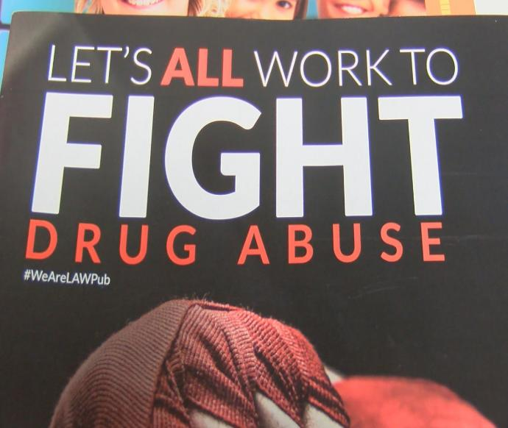
Conclusions and way forward
The impact is universal.
The solution lie with us.
Togetherness.
Juveniles are the future.
Notes:
Drug use among juveniles and teenagers affects everyone in the entire country either directly or indirectly. Therefore, available healthcare providers, community members, schools, and the government should all intervene by implementing programs and rules that will decrease juvenile rates in drug use. The only way forward is addressing the issue and backing the efforts suggested to fight this entire on the minors. Let us all join hands and work together towards saving the great minds of our upcoming generation.

Slide 8
References
Chakravararthy, B., Shah, S., & Lotfipour, S. (2013). Adolescent drug abuse-awareness &Prevention. Indian Journal of Medical Research, 137(6), 1021-1023.
Fishman, M., Bruner, A., & Adger, H. (1997). Substance abuse among children and adolescents. Pediatrics in Review, 18(11), 394-403
United Nations Office on Drugs and Crime. (2018). Drugs and Age: Drugs and associated issues among young people and older people. United Nations. Retrieved from https://www.unodc.org/wdr2018/prelaunch/WDR18_Booklet_4_YOU TH.pdf
Yuen, K.O.F. (2003). The consequences of drug use among youth and adolescents. International Journal of Adolescence and Youth, 11, pp 27-39

